Slide 1
Log Analytics Training

Slide 2
Agenda
Log Analytics overview
Demo
KQL
Log Analytics agents
Windows
Linux

Slide 3
Log Analytics overview
What is it? And how much $

Slide 4

What is Log Analytics
A platform for collecting data from variety of sources and querying it.
It is based on Azure resource called ‘workspace’.
Uses KQL language to query the data.
Has pricing tier based on data consumption.

Slide 5
What is a workspace?
Workspace is being used to store and query the collected data.
Workspace is a resource:
Manage RBAC model.
Workspace is created under a subscription and resource group.
Workspace is created in a specific region.
Workspace can be deleted.

Slide 6
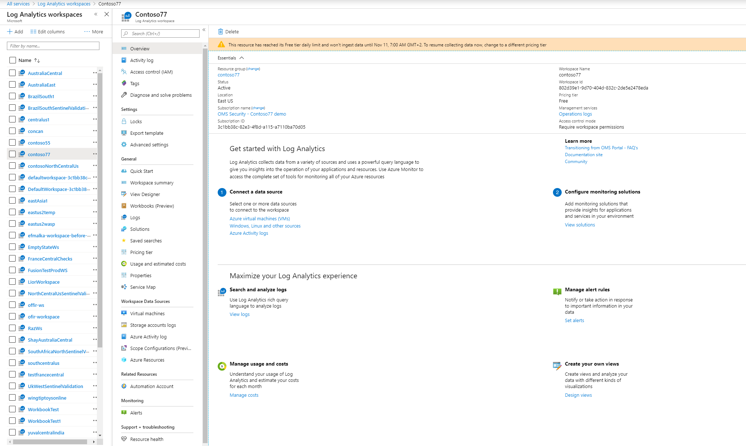
Workspace in Azure
All services > Log Analytics workspaces > Contoso77

Slide 7
Log Analytics pricing tier
Workspace has pricing tier which is based on the data consumption.
The pricing tier defines the daily data consumption allowance and the retention of the data.
The default pricing tier for new Azure Sentinel workspace is ‘Pay-as-you-go (Per GB)’.

Slide 8
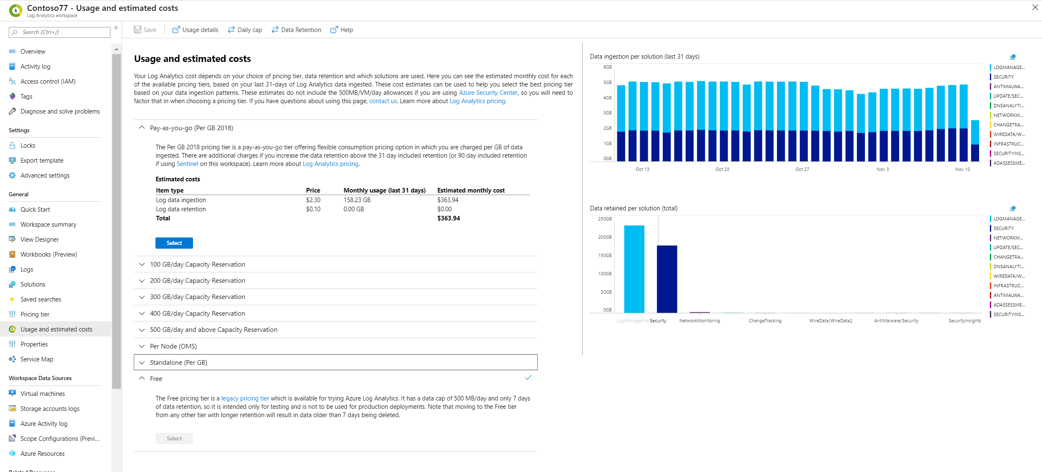
Changing workspace pricing tier
All services > Log Analytics workspaces > Usage and estimated costs

Slide 9
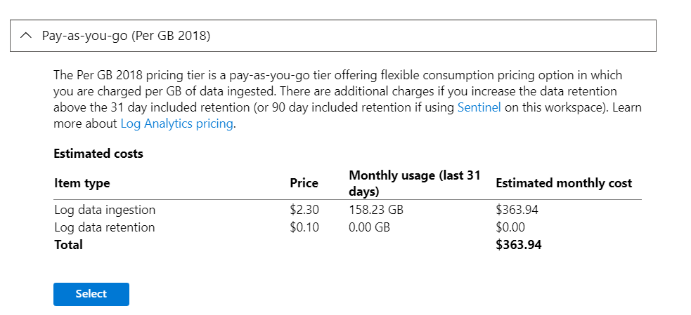
Default new Azure Sentinel workspace pricing tier

Slide 10
Log Analytics agents
Windows & Linux

Slide 11
Solution
Azure resource.
Permissions are being managed using RBAC model.
Defines the ‘Management Packs’ and the configuration that will be downloaded to the agent.
‘Management Packs’ define which data the agent should collect.

Slide 12
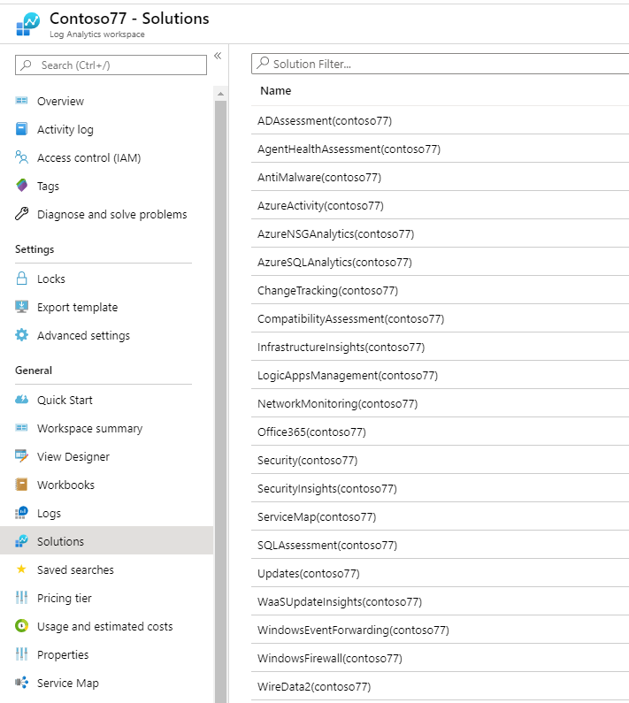
Solutions
All services > Log Analytics workspaces > Solutions

Slide 13
Log Analytic agent
Collects data from virtual machine or on-premise machines.
Can be installed on Windows or Linux.
When a virtual machine is connected, it sends ‘Heartbeat’ logs.

Slide 14
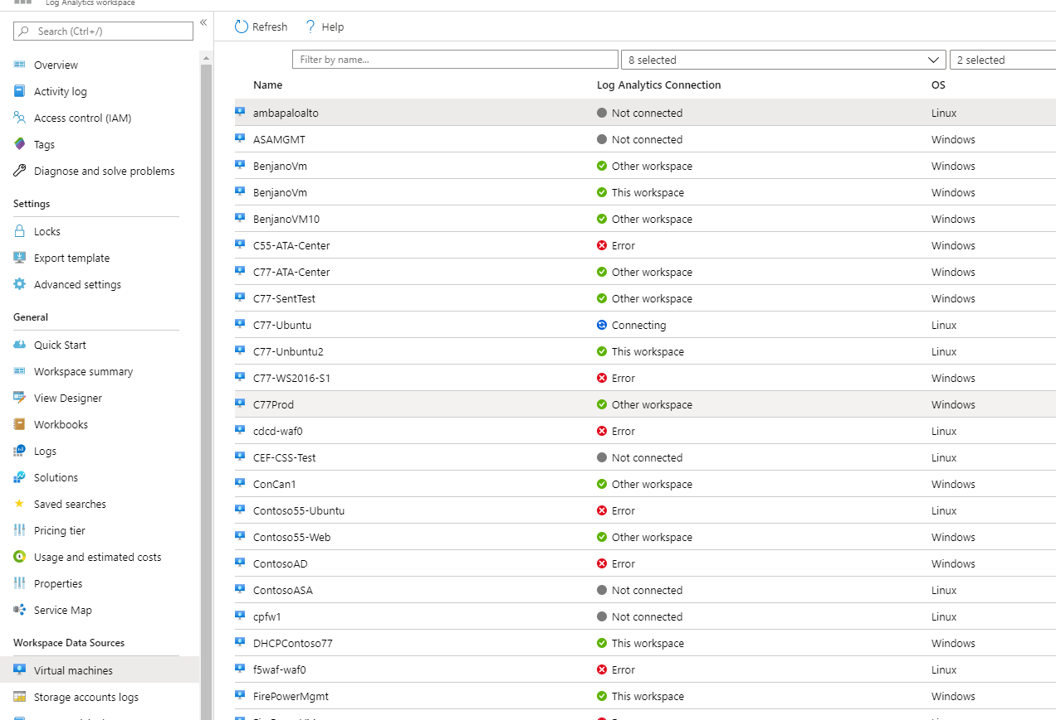
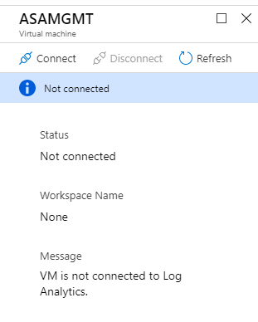
Install on virtual machine
All services > Log Analytics workspaces > Virtual machines

Slide 15
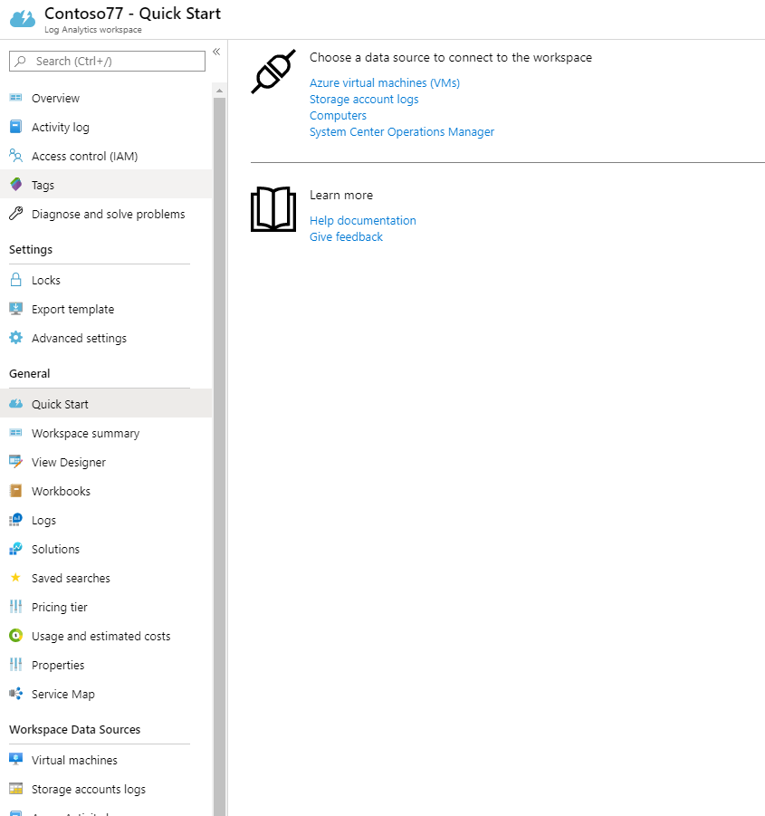
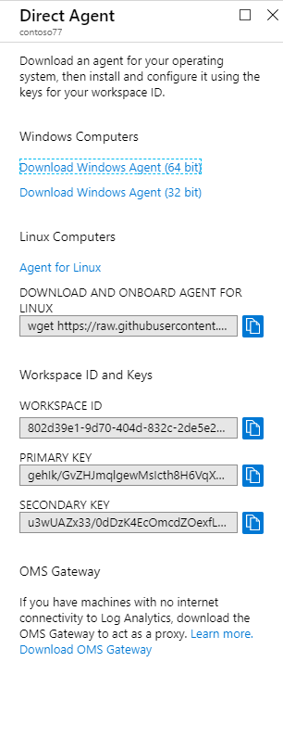
Direct Agent
All services > Log Analytics workspaces > QuickStart > Computers

Slide 16
Direct agent

Slide 17
No Data?
Check ‘Heartbeat’ logs and check if your Machine is connected.
Check the connector that should send your data is connected.
Reset the agent and verify that it is connected.
Check Event Viewer for errors.
Still no data? Open a ticket.

Slide 18
Windows Firewall solution
There are typically a lot of Windows Firewall logs.
To send those logs, you must configure your machine to save them into a file.
When the file reached to a pre-defined size limit, its record are being sent by the agent and a new file is created.

Slide 19
Common problems for Windows Firewall solution
File size limit is too small – might cause the agent to send too much data which cause data to drop.
There should be an error in ‘Event Viewer’ in case it happened.
Solution – increase the file size limit.
File size limit is too big – might cause a delay when sending the data.
Data will be sent only when the file size limit is reached.
Solution – reduce the file size limit.

Slide 20
Important things to know
It is not possible to have both SecurityEvents and SecurityInsightsSecurityEvents solutions.
The configuration of a solution affect the entire workspace.
If you have a problem installing Linux agent, contact Log Analytics.

Slide 21
Kusto query language (KQL)
The best thing ever happened to you

Slide 22
What is KQL?
Kusto query is a read-only request to process data and return results.
Therefore, it is not possible to modify data in Kusto.
The data will be available according to the workspace data retention.
A query is a collection of statements.
Statements starts with a reference to the table.
The data (rows) can be filtered using ‘where’ operation.
The result can be summarized using ‘summarize’ operation.
Statements will be bound together using ‘;’ delimiter.
Operations will be bound together using ‘|’ delimiter.
Notes:
; - semicolon
| - pipe

Slide 23
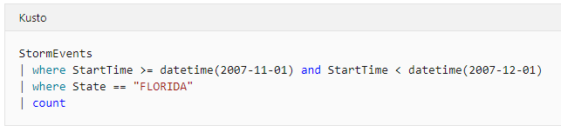
Example query 1
‘StormEvents’ – the table
‘StartTime’ & ‘State’ – columns.
‘Where’ operation – filter according to StartTime and State
‘count’ operation – summarize the results.
Notes:
; - semicolon
| - pipe

Slide 24
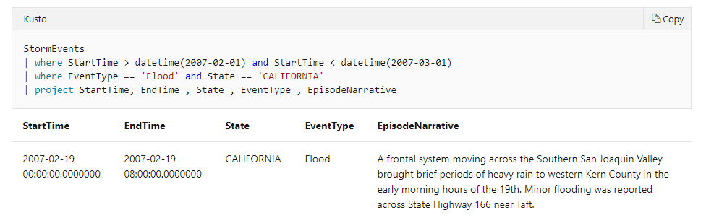
‘project’ Operator
Project will return only the specified columns.
Notes:
; - semicolon
| - pipe

Slide 25
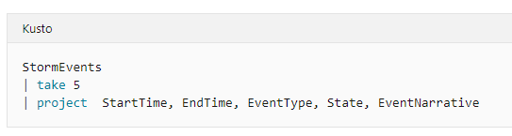
‘take’ Operator
Take will return rows in no particular order.
‘limit’ operator is an alias for ‘take’.
Notes:
; - semicolon
| - pipe

Slide 26
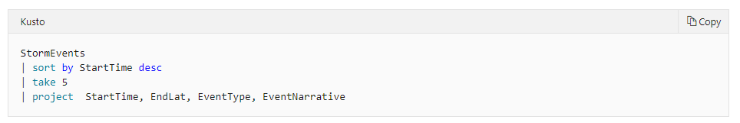
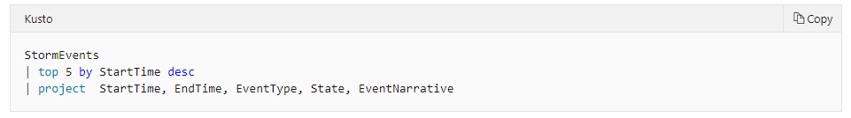
‘sort’ Operator
Sort will return sorted results according to the specific columns.
Top is a syntactic sugar that combine sort and take.
Notes:
; - semicolon
| - pipe

Slide 27
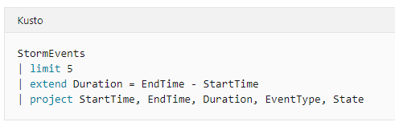
‘extend’ Operator
Create a new column by computing a value in every row.
Notes:
; - semicolon
| - pipe

Slide 28
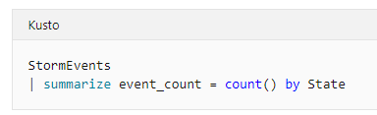
‘summarize’ Operator 1
Summarize group together rows that have the same values in the by clause.
It uses the aggregation function (such as count) to combine each group into a single row.
Notes:
; - semicolon
| - pipe

Slide 29
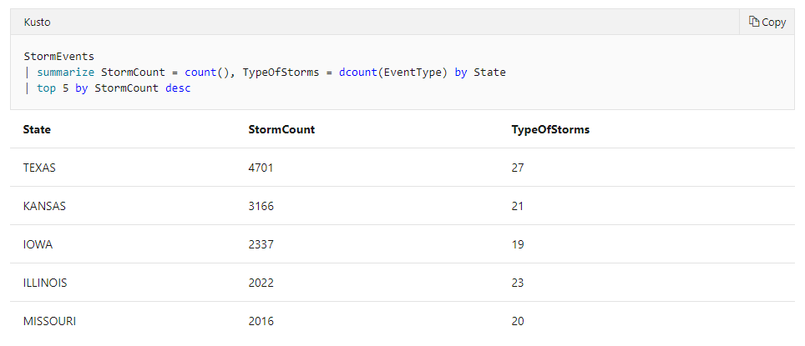
‘summarize’ Operator 2
Summarize group together rows that have the same values in the by clause.
It uses the aggregation function (such as count) to combine each group into a single row.
Notes:
; - semicolon
| - pipe

Slide 30
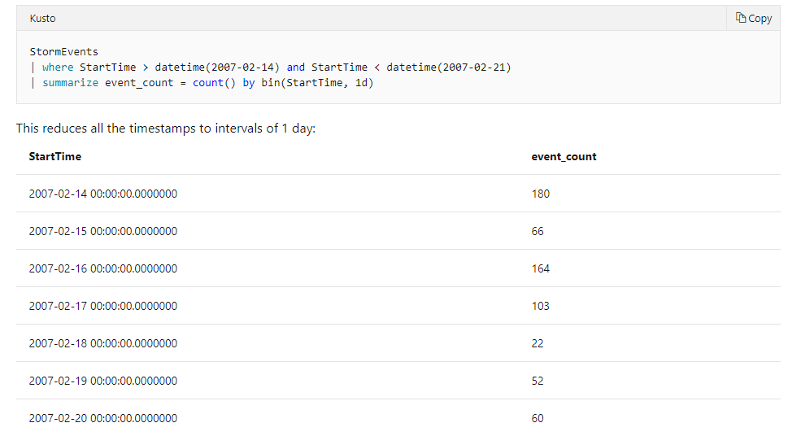
‘summarize’ Operator 3
‘bin’ is a very useful function that allows aggregating results into ‘buckets’.
For example, event_count per day (bucket)
Notes:
; - semicolon
| - pipe

Slide 31
Common problems
With easy solution

Slide 32
Time range.
Time scope.
Too much filters.
Not filtering the right product.
Not connecting the data.
Reached data consumption limit.
Search is not working – LA status.
Search across different products such as AI.
Throttling.
Unauthorized.
Adding custom log.
Missing data.

